Slide 1
DRINKING AND TECHNICAL WATER DISINFECTION AND TREATMENT (WITH AQUATON® POLYMER REAGENT)
 | Chlorine | Chlor-amines | Ozone | UV | Aquaton
Disinfection | + | + | + | +/- ** | +
Conservation at t<20°C | +/- * | +/- * | - | - | +
Conservation at t>20°C | - * | +/- * | - | - | +
Long-time conservation | - | - | - | - | +
Absence of toxic by-products | - | - | - | + | +
Residual stability in water | - | +/- * | - | - | +
Absence of corrosion action | - | - | - | + | +
Absence of by-products nutritious for microorganisms (BDC) *** | +/- | +/- | - | + | +
Flocculant | - | - | - | - | +
Heavy metals removal | - | - | - | - | +
Safety of transportation, storage, use | - | - | - | +/- ** | +
Compartible with ion exchange | + | + | + | + | +/-
* - chlorine/chloramines have conservation post-effect because of residual concentrations after treatment, but they are unstable (chloramines is more stable than chlorine) in water, especially at high temperatures, so conservation is not a long-term and not always effective.
** - as shown in recent investigations, UV don’t disinfects, but suppresses microorganisms. Also, UV lamps contain mercury and operate at high voltage, so being damaged/misused could be unsafe for personnel.
*** - some treatment processes, especially ozonation, produce nutrient for microorganisms by-products, that results in high secondary growth of microorganisms in treated water.

Slide 2
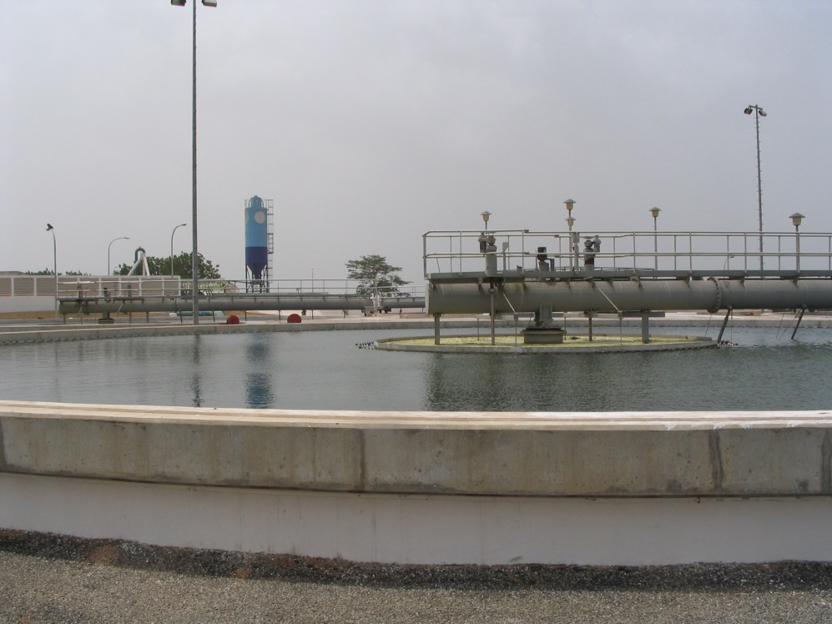
DRINKING AND TECHNICAL WATER DISINFECTION AND TREATMENT (WITH AQUATON® POLYMER REAGENT)
DESCRIPTION
This water disinfection technology uses special non-toxic water-soluble polymer reagent to decontaminate the water as well as preserve it. The substance used is harmless to the health of humans and animals. Meanwhile, the applied reagent produce no additional harmful substances.
Technology guarantees high barrier for different water-spread diseases types – bacteria, viruses, fungi, protozoa.
Use of reagent allows significally decrease (up to several times) amount of coagulants and other helping reagents used in water treatment.
Technology allows long-time conservation of treated water (even in high temperature conditions) – up to 1 year and above.
Existing water treatment plants in most cases could be converted to this technology without significant investments in modernization.
Given technology is currently used at various industrial, municipal and local water treatment facilities in Ukraine and Ghana.
KEY NUMBERS
Productivity – from 1,000 m³/day;
20,000 m³/day treatment facility approximate initial cost – $2 million;
Cost of 1m³ of purified water – $0.016 - $0.3;
Payback period – 1 year.

Slide 3
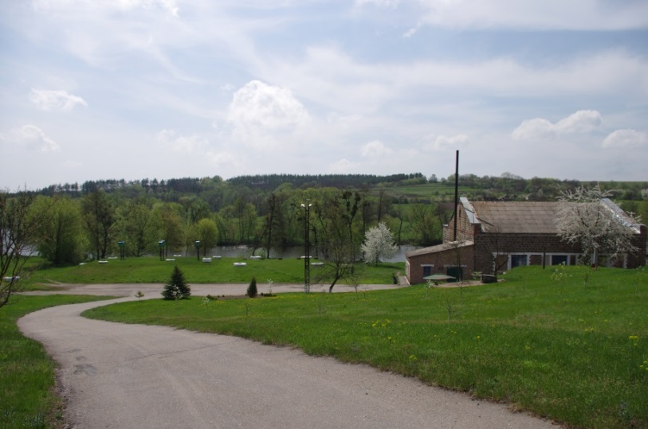
DEZHKY WATER TREATMENT PLANT (ROS’ RIVER, MIRONOVKA, KYIV REGION).
Pilot test started during spring floods period (march-may).
During this period, turbidity was as high as 20 NTU, color - 60-70 HU.
Treated water fully satisfy lukrainian standards (ДСанПиН) - color – 10-15 HU, turbidity – 1.2-2.0 NTU.
Moreover, during test period two microbial pollution outbreaks in river happened (E.Coli reached 200 000 per 1 см³) as a results of wastewater breakouts on Bohuslav wastewater processing plant 5 km upstream.
Use of Aquaton® reagent in doses 2-4 mg/dm³ secured reliable disinfection during all test period - no E.Coli was found during test in treated water.
Citizens of Myronovka highly ranked quality of drinking water during test - taste, odor, cplorduring test was significantly better than before.
Myronivka water treatment plant located at Dezhky willage on Ros’ river. River is small, significantly polluted with wastewater from Bila Tserkva, Bohuslav and other towns upstream.
Treated water supplied to Myronivka by pipeline 20km long, built in XIX century.
To maintain epidemic safety water treated with high dosage of chlorine (up to 8 mg/dm³), what results in high pollution of drinking water with chloration byproducts.

Slide 4
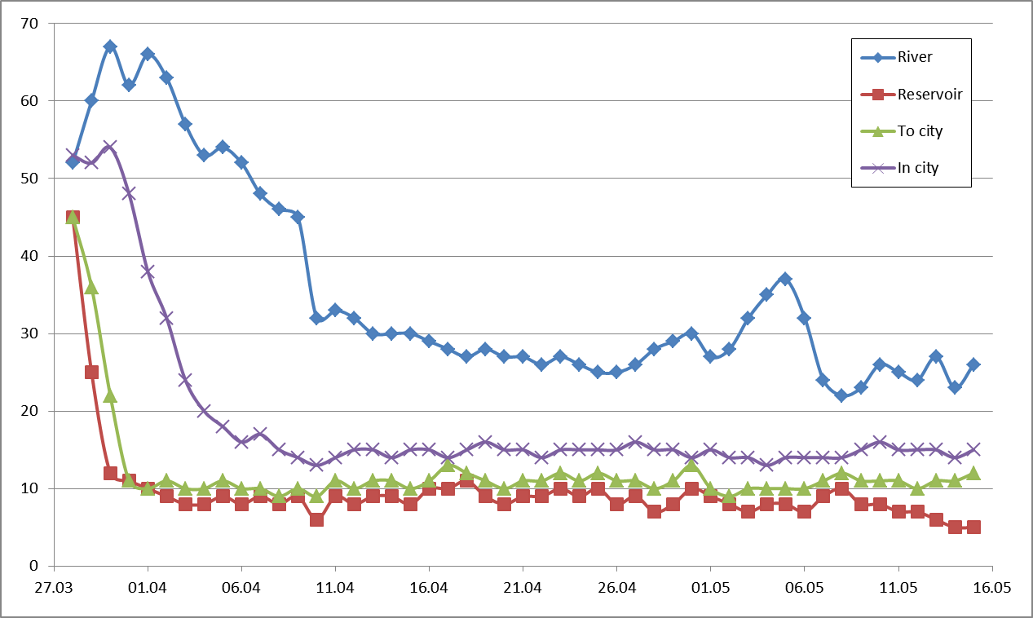
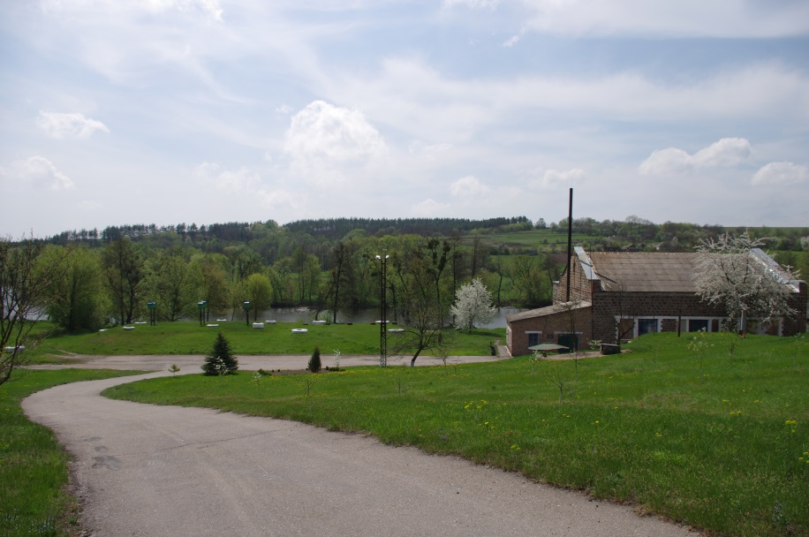
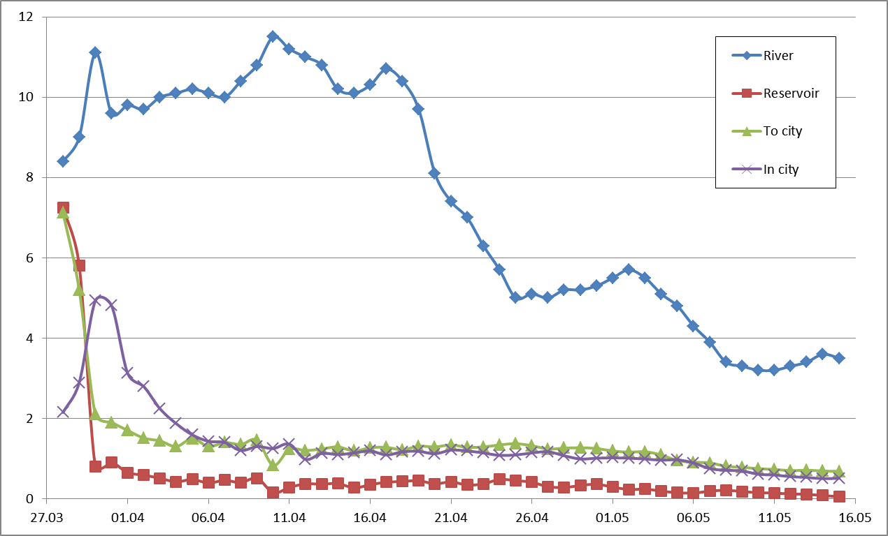
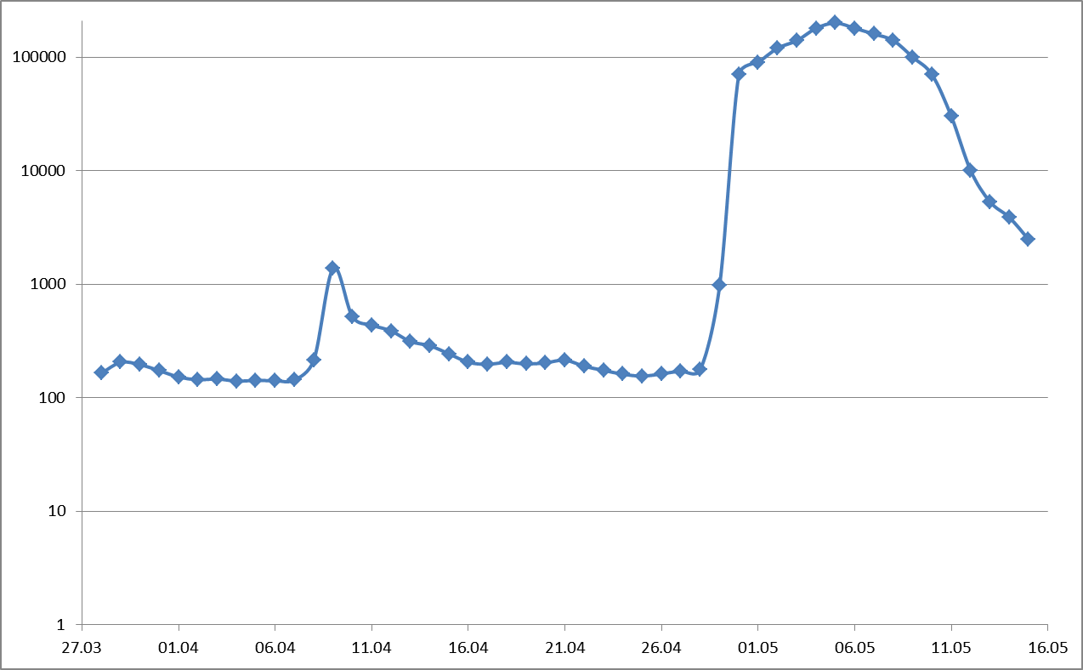
RESULTS ON DEZHKY WATER TREATMENT PLANT:

Slide 5
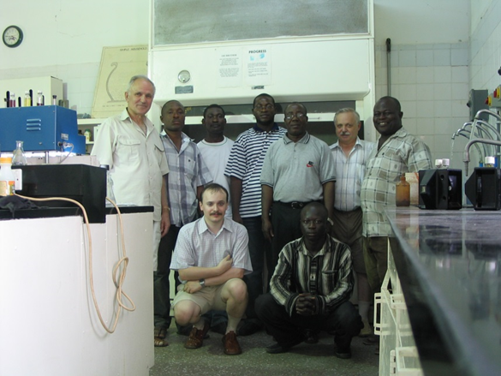
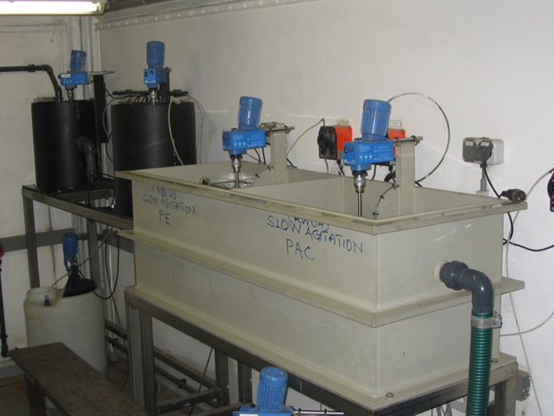
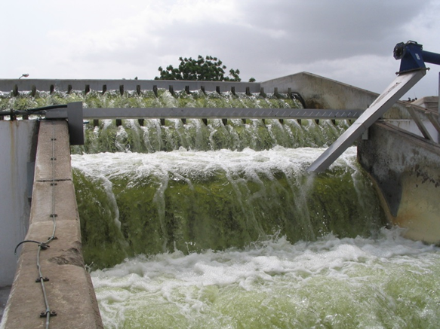
Weija pilot plant (Densu river, Accra, Ghana)
Test on pilot plant shown, that application of Aquaton® reagent in water treatment at 1.5-2.5 mg/dm³ together with decrease of coagulant dose 1.5-2 times, treated water satisfies requirements of WHO, also ensures robust disinfection and conservation of water despite of very high level of bacteria pollution.
Traditional technology not always can satisfy WHO requirements and require additional post-treatment to ensure chemical aqnd microbiological safety of treated water.
 | Reagent | Dosage
 | Coagulant, mg/dm³ | Исх. вода | Треб. ВОЗ | 40 | 60 | 80 | 40 | 50 | 60 | 40 | 50 | 60
 | Aquaton®, mg/dm³ |  |  | - |  |  | 1,5 |  |  | 2,5
Показатели | Color, HU. | 192 | 15 | 85 | 50 | 29 | 20 | 15 | 10 | 10 | 5 | 1
 | Turbidity, NTU | 6,84 | 3(5) | 2,92 | 1,68 | 1,56 | 2,29 | 1,99 | 1,55 | 1,74 | 1,08 | 0,92
 | Total Coliforms, spc/ml | >10⁶ | 0 | 380 | 320 | 290 | 5 | 0 | 0 | 0 | 0 | 0

Slide 6
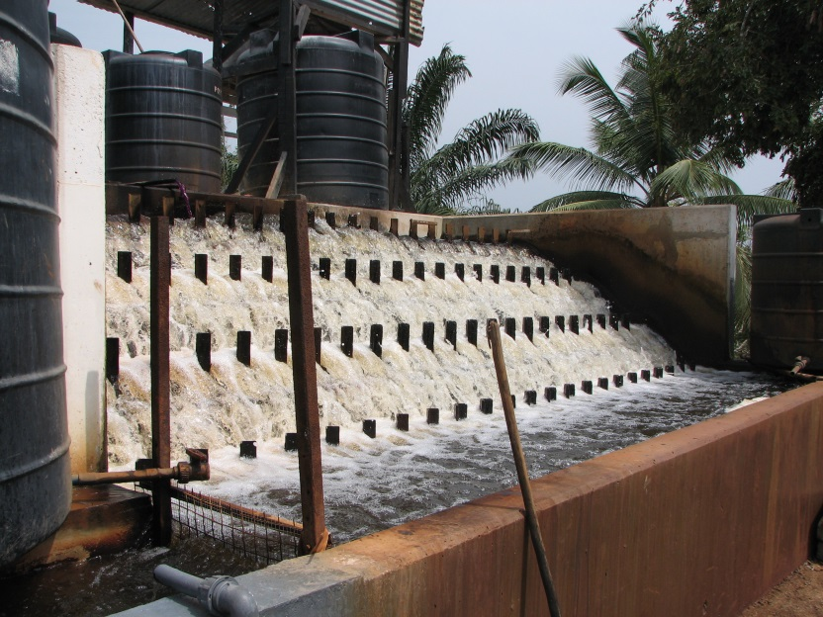
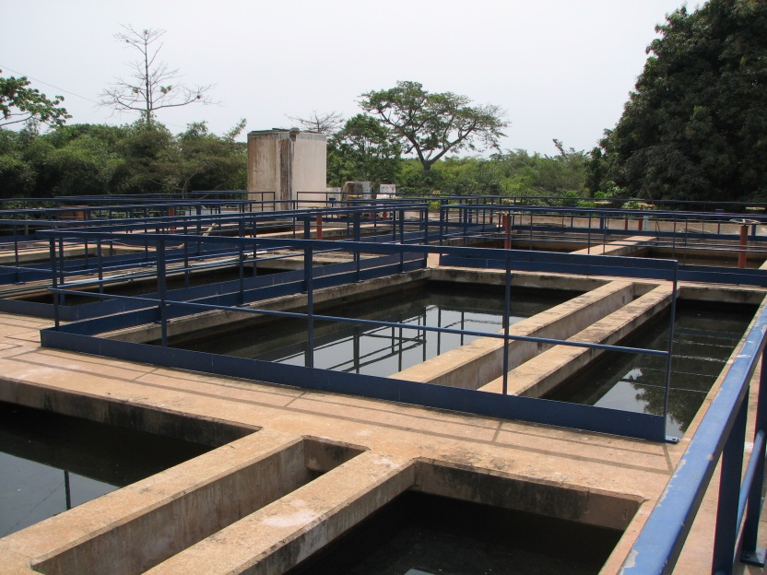
Brimsu pilot plant (Kakum river, Cape-Coast, Ghana)
Raw water from Kakum river, have high color (242 HU) and turbidity (13.5 NTU), also polluted with high levels of Ferrrum (4.28 mg/dm³), what requires additional chemical treatment for decrease of Ferrum.
Low alcalinity do not allows to use coagulant effectively, so addition of lime to increase alcalinity required.
Application of Aquaton® reagent at 1.5-2.0 mg/dm³ allowed to decrease dose of coagulant 3 times, meetigate requirements of WHO as by color (5 HU) and turbidity (0.87 NTU), also by residual Ferrum (0.02-0.5 mg/dm³). As result, no addition of lime and additional treatment from Ferrum do not required.
Also ensured durable disinfection and conservation of treated water.

Slide 7
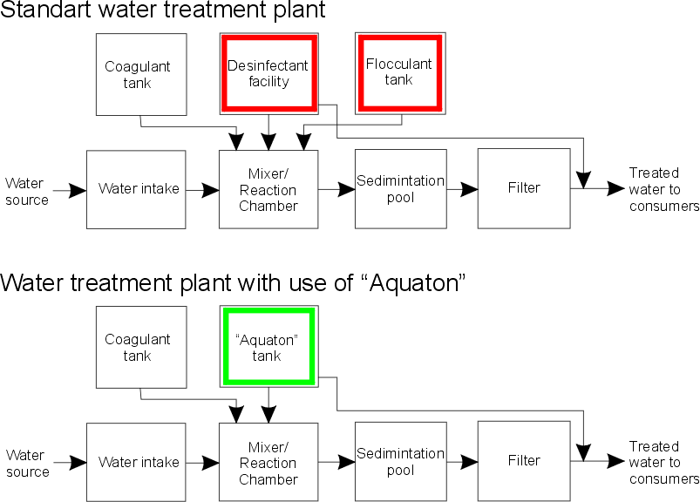
ECONOMY ON AQUATON® USAGE:
Cost of water treatment with Aquaton® per m³:
- Reagent Aquaton® - $0.016 - $0.3 (depending on pollution of raw water);
- Other reagents (coagulant, pH-correction, descalants, etc. – depending on raw water quality and requirements – determined on site);
- Electric power – 0.02 – 0.5 KW h (depending on pumps and other equipment installed on site).
Water treatment plant migration to usage of Aquaton® No need of serious reconstruction of existing water treatment plants
Economic advantages of Aquaton®:
Reduces and prevents corrosion processes – water treatment and distributing equipment works much longer;
Reduces biofouling of water distribution network – water pumps consume less (up to 15-20%) electric power;
Reduces amount of coagulants used (up to 3-5 times);
Replaces cationic flocculants;
Reduces use of pH-correctors and reagents for Fe sedimentation;
Increases duration of filtration cycle – less consumption of “return water” (treated water, used for filter cleaning);
Safe for personnel during transportation, storage and use – no need of special equipment and safety provisions.
Transfer of existing water treatment plant in most cases do not require investment in plant reconstruction or additional equipment – most of the existing equipment still be used with new technology.

Slide 8
WATER CONSERVATION (WITH Aquaton® POLYMER REAGENT)
DESCRIPTION
In many regions annual rainfall is huge, but rain period is very shot (2-3 months), so to use rainwater as a source for drinking water there is a need for proper water storage and conservation.
Water disinfection and conservation technologies, already present at the market, do not guarantee for long-time conservation and work poor in high-temperature climate.
Our technology allows store and durable conservation of drinking water up to 1 year and above.
Reagent is non-fugitive and stable even at high temperatures (where traditional technologies fails).
Reagent is non-aggressive, non-toxic for humans and animals, do not cause corrosion and other destruction of tanks, pipes and other infrastructure, do not require any special conditions on transportation, storage, use.
KEY NUMBERS
Cost of conservation of 1m³ of purified water – $0.016 - $0.15;
Small amount (1-3 ml/m³) of reagent needed for long-time conservation.

Slide 9
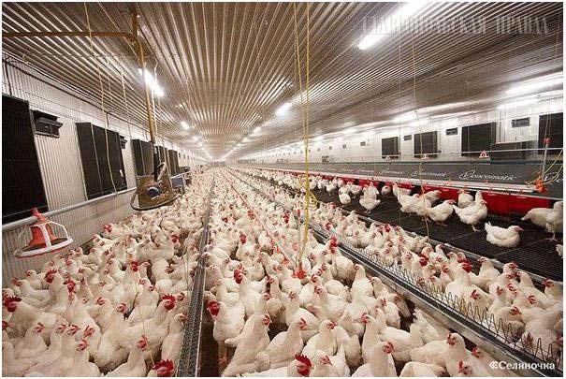
Преимущества применения реагента Акватон в очистке и консервации воды в сельском хозяйстве
Качественная дезинфекция воды:
Предотвращение развития в почве фитопатогенов, снижение поражения корней растений гнилостными микроорганизмами, грибками;
Повышение сохранности овощей, фруктов, корнеплодов, зерновых при хранении;
Предотвращение заражения животных и птиц патогенными микроорганизмами, предотвращение эпизоотий.
Консервация воды:
Предотвращение роста патогенных микроорганизмов в резервуарах-накопителях;
Предотвращение переноса инфекций животных и птиц через общие поилки.
Результаты:
Повышение урожая овощей, фруктов, корнеплодов, зерновых;
Снижение и предотвращение падежа скота и птицы из-за болезней.

Slide 10
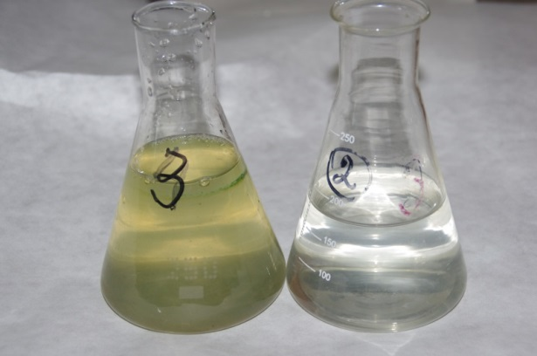
PORTABLE WATER TREATMENT SYSTEM
Compact portable water treatment system for platoon or small squad to be used in field
Produces treated, safe drinking water, using water from available sources – wells, rivers, lakes, swamps, drainage and irrigation systems, etc.
Treats contaminated or potentially unsafe water from microorganisms (bacteria, virii), pesticides, heavy metals and other dangerous pollutants
Productivity– more than 1000 liters of treated water on single set of expendable materials. Spare set present in system backpack
Do not require electricity or other sources of energy – system driven by muscle of serviceman and fully autonomous
Explosion and fire safe, do not contain any toxic substances

Slide 11
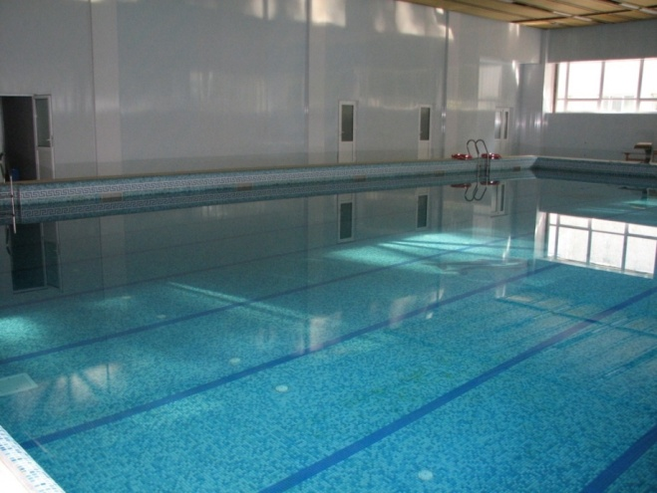
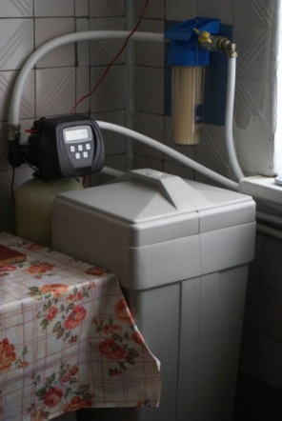
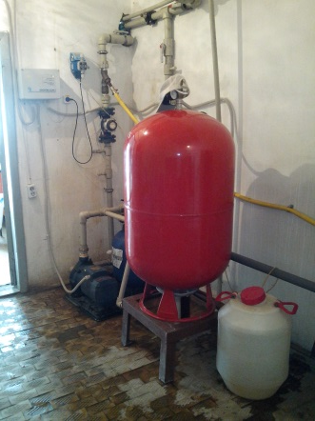
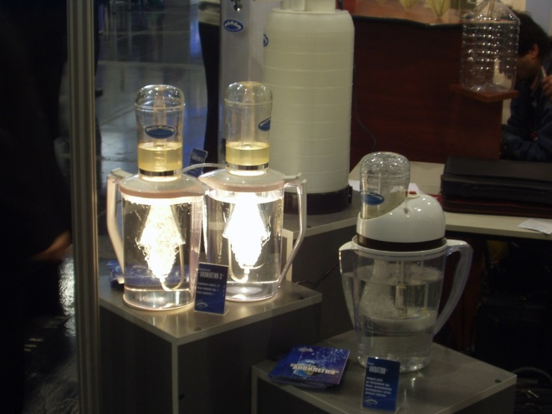
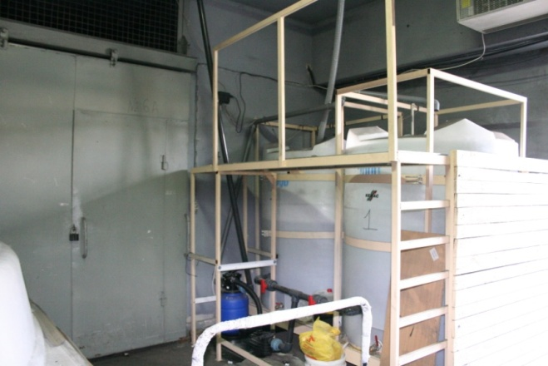
OTHER USES OF POLYMER REAGENT WATER TREATMENT TECHNOLOGY
Storage and transportation of drinking water
Medium and small-size water treatment systems
Personal water treatment systems
Mobile water treatment systems
Wells disinfection
Swimming pools
Bottled water production
Equipment disinfection
Food industry
Turnaround industrial water supply systems

